Slide 1

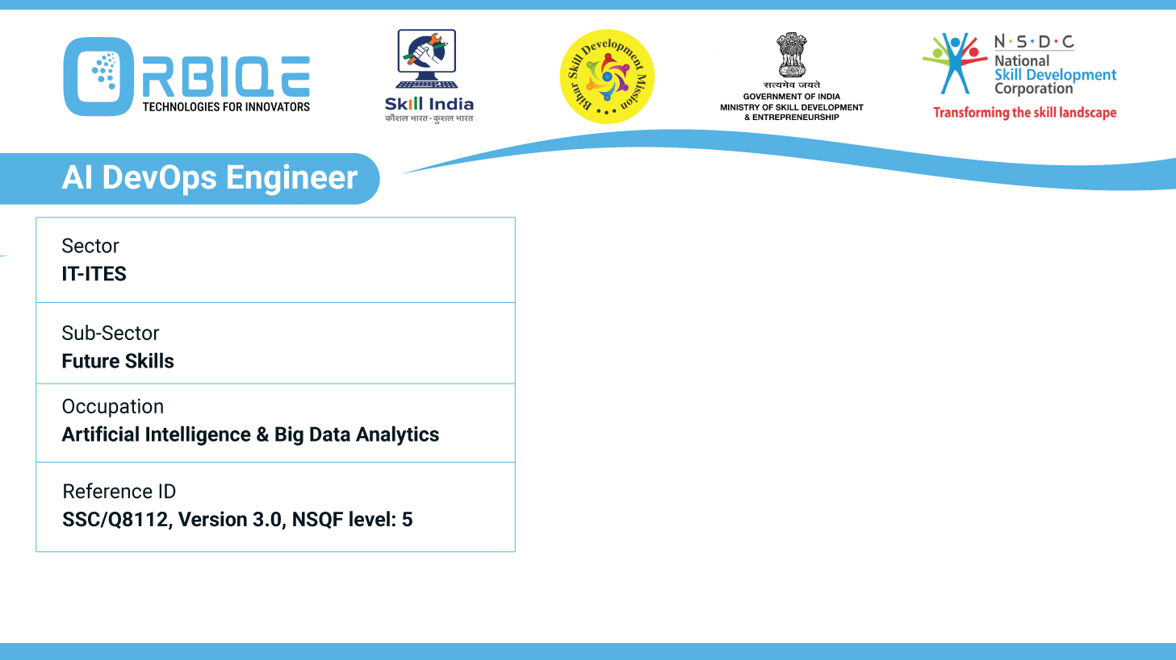
Name- Krishna Kant Dubey

Slide 2

Management and Automation of Configuration with Puppet, Chef, and Ansible

Slide 3
Agenda
Uses Puppet DSL to define configurations and manifests, supports master agent architecture for centralized management
Employs Ruby-based DSL for defining configurations, offers both push and pull models for configuration deployment
Uses YAML syntax for defining configurations, agentless architecture for easy deployment and management

Slide 4
Uses Puppet DSL to define configurations and manifests, supports master agent architecture for centralized management

Slide 5
Employs Ruby-based DSL for defining configurations, offers both push and pull models for configuration deployment

Slide 6
Uses YAML syntax for defining configurations, agentless architecture for easy deployment and management

Slide 7
Thank You

